Slide 1
Reading in Cowichan
Tiered System of Support: Considering Structure, Instruction, and Culture
Notes:
To embed in all as appropriate:
Multi-sensory
Play-based
Trauma-sensitive
Validate what’s happening already
First Peoples Principles of Learning
Connect to Strategic Plan
Culture of Care

Slide 2
"Only once a strong and well targeted instructional core is in place (tier 1), can we build interventions that will serve as truly supplemental and supportive instruction."
Notes:
A strong core program teaches all students necessary skills in a classroom setting. Differentiated instruction can be included. Throughout this process, the classroom teacher monitors the progress of students and notes students who are struggling and falling behind their peers.

Slide 3
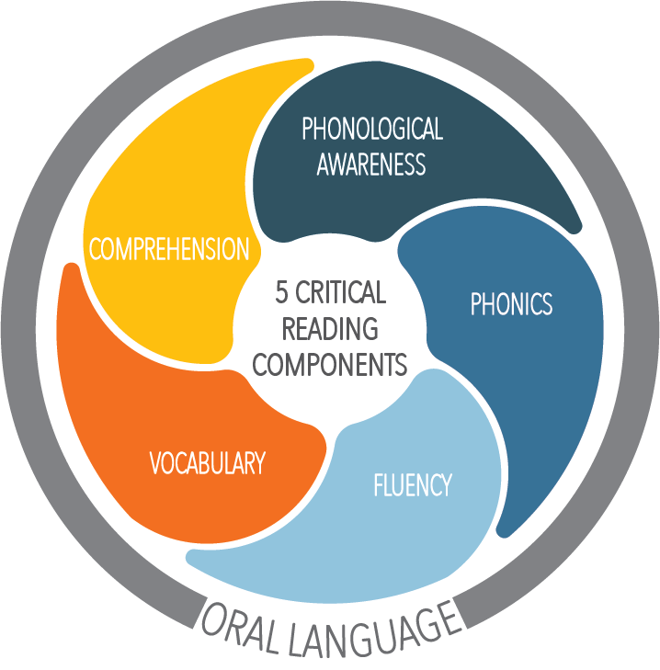
Tier One
Practices
Tier 1 instruction is delivered to all students and attempts to prevent learning gaps from developing.
This Photo by Unknown Author is licensed under CC BY
Notes:
Tier 1 is the key component of tiered instruction, where all students receive instruction within an evidence-based, scientifically researched core curriculum.
Effective tier 1 instruction prevents the number of students in Tier 2 and 3 interventions. It is critical to choose instructional tasks with the highest efficacy rates to ensure needs are being met for all learners.

Slide 4
"The Lingering Effects of Unfinished Learning" (July 2021), estimates that on average students started this year four months behind in reading, and for those students in low-income schools, the gap was even wider.
Mckinsey & Co.
Notes:
Throughout the world, educators are seeing increased learning gaps and deficits due to the pandemic.

Slide 5
All five critical components of reading are a part of Tier One instruction in varying ways.
Notes:
The five critical components are all equally important and included in a quality literacy instruction. Components may need more emphasis in the different developmental stages of reading that learners progress through. For example, students in grades K-2 will need more instruction and exposure to phonological awareness and phonics than a "typical" learner in intermediate grades may need. All students require a firm foundation in all components; a deficit in one area will create difficulties in others.

Slide 6
The Essential Components of Literacy
Skill | Expectation | Typical Grade Range
Phonemic Awareness | Noticing, thinking about and working with phonemes (the smallest units of spoken language) | K-2
Phonics and Word Recognition | Knowing relationships between sounds (phonemes) and letters (graphemes) Apply grade level phonics and word analysis skills in reading and writing words | K-7
Reading Fluency | Reading connected text accurately, fluently and for meaning | 1-12
Reading Comprehension | Gaining meaning from text independently and listening to reading | K-12
Vocabulary and Oral Language | Understanding the meaning of words we speak, hear, read and write | K-12
Simple Complex
Stephanie Stollar Consulting
Notes:
The National Reading Panel Report (2000) in the USA summarized several decades of scientific research, from around the world, that clearly shows effective reading instruction addresses five critical areas.

Slide 7
Key Ingredients for Effective Tier 1 Practices
90-120 minutes of reading instruction each day is optimal in an elementary setting.
Instruction follows a research-based scope and sequence that includes the five essential early literacy skills in a coherent, comprehensive core reading program.
Research-based instructional routines and materials are utilized to teach reading.
Instruction is differentiated based on universal screening data.
Instruction can be delivered in whole group and small group formats, based on student data and needs.
Culturally responsive academic instruction is considered.
Notes:
One of the most important things we can do is ensure the quality of Tier 1 instruction. It’s really the relationship between the teacher and student and what’s happening in the classroom that’s most important.
What does it mean to have great, high quality, Tier 1 instruction? It should be consistent and evidence-based. It addresses the needs of your students.
It also means differentiation. One of the best things you can do to strengthen Tier 1 instruction is use the fact that some students are struggling, identify why they are struggling through Universal Screening and really build that into the way in which we’re instructing for all students. Along with meeting students' needs is know who they are through culturally responsive instruction. Click the link to read more about Culturally Responsive teaching - Culturally responsive

Slide 8
Key Research Points
• Training in manipulation of phonemes in spoken words and with letters improves reading and spelling • Explicit, systematic phonics instruction improves decoding, spelling and reading comprehension skills • Guided, repeated oral reading instruction improves decoding, fluency and reading comprehension skills • Vocabulary instruction improves reading comprehension • Comprehension instruction should include explicit teaching of strategies and of strategic reasoning
Screening and continuous assessment informs instruction
NRP Report
Notes:
We know from research that an effective reading program must address several aspects of reading . Among others, these aspects include the alphabetic code, fluency, vocabulary and comprehension.

Slide 9
Instruction should be...
Structured and systematic with a scope and sequence
Explicit
Differentiated across the classroom
Assessed through progress monitoring
Engaging and play-based in primary grades
-Reading Rockets
Notes:
Structured Literacy prepares students to decode words in an explicit and systematic manner. This approach not only helps students who have reading stretches, but there is substantial evidence that shows it is more effective for all readers. Teachers guide students through systematic mastery of the smallest units of sounds (phonemes) and build upon that knowledge by introducing new, more complex material (morphemes, advanced vocabulary) in a structured and cumulative way.

Slide 10
What does explicit, systematic and sequential mean?
Explicit | Systematic | Sequential
-New skills are directly modeled and explained -Teacher provides guided practice (I do, We do, You do) -Students are guided to the correct response through prompts and feedback -Error response includes immediate corrective feedback -Skills are practiced to mastery and automaticity Webinar Podcast | -Skills and concepts begin with simple and move to complex -Student objectives are clear, concise, and driven by ongoing assessment results -Consistent instructional routines are used to guide students to correct responses -Students are provided with practice opportunities to directly reflect explicit instruction -Cumulative review | - Pre-requisites are taught first -Skills are taught in order from easier to harder -Foundational skills are taught directly to support higher-order skills -Intentional sequence within and across lessons; within and across grades
Explicit Intstruction
VALUE Series
Stephanie Stollar Consulting
Florida Center For Reading Research
Notes:
Breaking down reading and language into distinct skills is beneficial to make sure no children fall through the cracks. Giving students well developed tools for decoding frees up cognitive energy for higher order comprehension skills.
Systematic, sequential and explicit phonics instruction significantly improves children's reading comprehension.
Explicit instructions refers to lessons in which skills and concepts are clearly explained, and modelled without vagueness or ambiguity.
Systematic phonics lessons are organized in such a way that newly introduced skills are built on existing skills, and tasks are arranged from simplest to most complex. (Core 171)

Slide 11
Differentiated Instruction In a Tier One Setting
In addition to providing grade level content, differentiated instruction for student’s individual needs and abilities is crucial. This can be accomplished by the teacher working with an individual or with a small group of students.
Differentiated reading instruction is:
Teacher-led
Individual or small group
Matching instruction to diverse needs
Flexible
Data driven
Listen to Dr. Julie Washington discussing linguistic variety as differences, not errors, and how to best support all students as they learn to read.
Differentiated Literacy Instruction: I, We, You
Notes:
Reading instruction at the tier 1 level includes all students and should cover all components of reading. Students come to school with a wide variety of skills, abilities, and interest as well as varying proficiency in English, and other languages. Through the combination of whole-group and small– group differentiated instruction, 95 percent of students should attain school-wide reading goals and meet screening benchmarks. Differentiated instruction meets the needs of students with reading difficulties, students with disabilities, advanced learners, and English-language learners.

Slide 12
Recommended Learning Activities
Phonemic Awareness | Phoneme-Grapheme Correspondences | Decoding, Encoding | Fluency (scroll down page) | Vocabulary & Comprehension (scroll down page) | Writing
-Sound Wall-phoneme focus -Heggerty drills: segmenting, blending, manipulating phonemes -See It Sound It -Elkonin Boxes -Phoneme Counting -Say It-Move It Developing Oral Language to Support K-3 Literacy Instruction Handout | -Visual Drill -Auditory Drill -ABC Order practice -Alphabet Arcs -Concept Introduction -Elkonin Boxes -Search text for target phonics pattern -Sort phonics pattern into different spellings -Phonics Games/Apps The Power Tools For Word Work Webinar | -Blending Drill -Dictation -Word Sort -Word Work Phonics Mats -Regular Word Spelling -Syllable Patterns -Morphology -Spelling Instruction That Sticks -Spelling Error Analysis Irregular & High Frequency Words -Irregular Word Practice -High Frequency Word Practice -Heart Word Magic | -Partner reading -Read Alouds -Supported Reading -Independent Reading -Repeated Reading -Choral Reading -Partner Reading -Decodable books and passages -Listen to Audio book -Reader's Theatre Sequence from simple to complex: Letter-Sound Correspondence Word Parts Words Phrases Chunked Text Connected Text | Through read alouds, novel studies, quality, rich literature – fiction and non-fiction: -Robust vocabulary instruction -Morphology -Pre-reading strategies -During reading strategies -Post-reading strategies -Retelling -Summarizing -Visualization -Inference -Questioning | -Letter formation -Fine motor skills -Dictation -Sentence Writing -Paragraphs -Independent Writing -Grammar Instruction -Graphic Organizers -Virtual Lessons Why is explicit writing instruction essential for adolescent learners? Stages of the Writing Process Gr. 4-12
Notes:
These are a collection of research-based activities with high efficacy rates. Our time is limited with our students and choosing high quality instructional routines and activities is important.

Slide 13
Resources
Phonological Awareness | Phonics | Fluency | Vocabulary | Comprehension | Writing
Heggerty Road to the Code Equipped for Reading Success Bridging the Gap Sound Walls | West Virginia Phonics Tara West's Guided Phonics and Beyond UFLI: Foundations Right Track Reading Road To Reading Decodable Readers Rewards: Multisyllabic Word Reading Strategies Phonics and spelling Through Phoneme-Grapheme Spelling A Fresh Look At Phonics Spelling For Life Reading For Life | PALS (partner reading strategy) Helps For Passages: Newsela Read Works DIBELS Acadience ThinkFluency Easy CBM HELPS Decodable Passages | CORE Teaching Reading Sourcebook Morpheme Magic Bringing Words To Life Rewards Vocabulary Beneath The Surface of Words Etymonline | Read Works Newsela Reading A-Z The Reading Comprehension Blueprint | Writing Revolution The Writing Rope
Notes:
There are many options for choice of programs, curriculum and resources. The Reading League has a great curriculum evaluation tool to decide if a curriculum or program is research based and proven effective. Reading League Curriculum Evaluation Tool

Slide 14
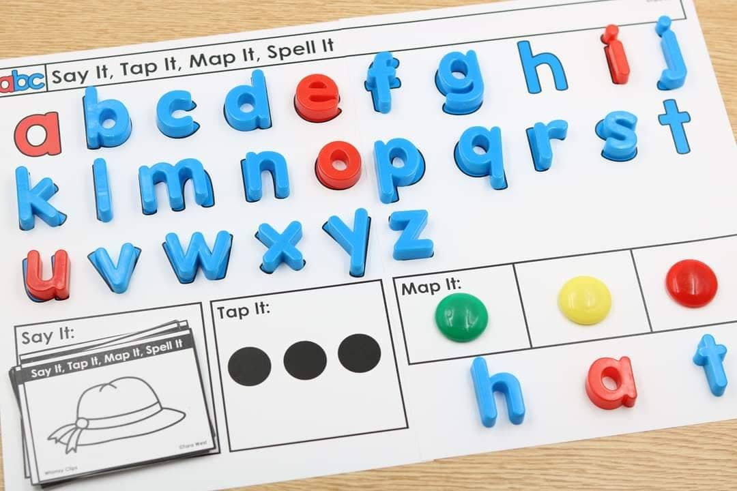
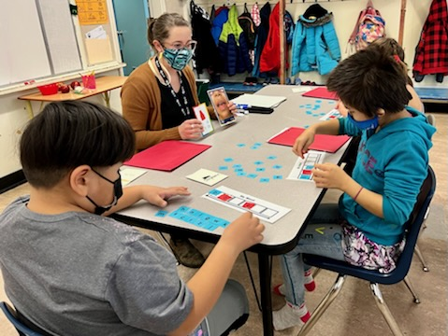
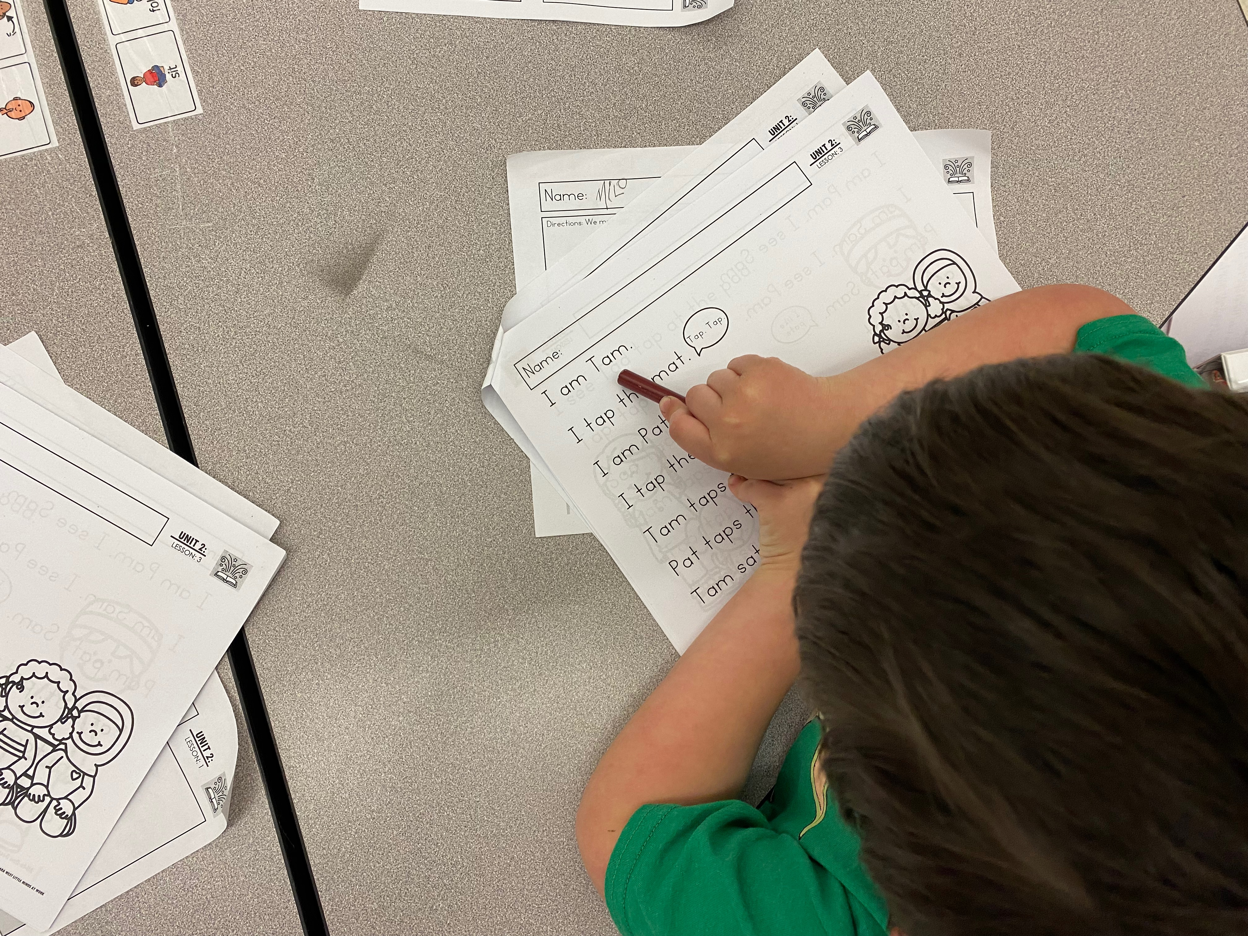
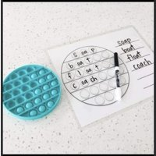
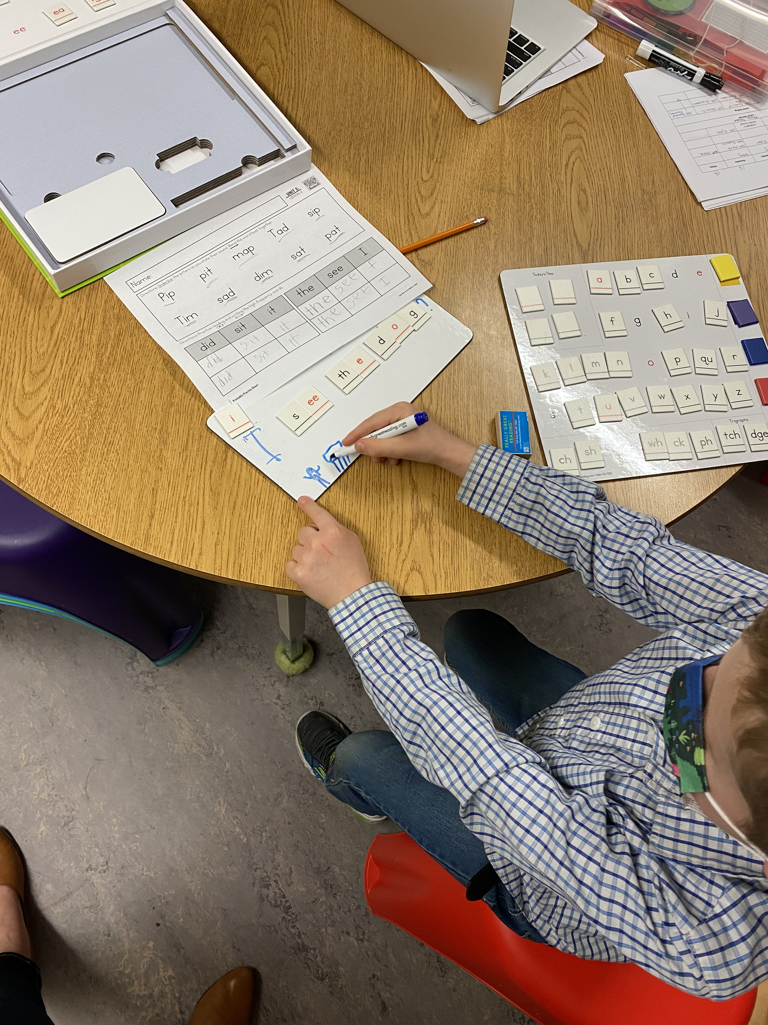
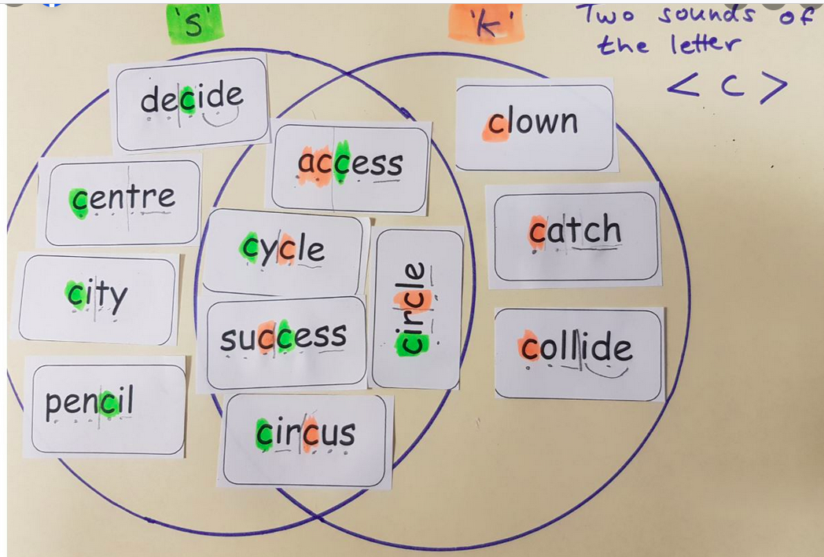
What Can Tier 1 Look Like?
Activities for Grades K-3
Notes:
Tier 1 instruction can include hands-on, multi-sensory activities.

Slide 15
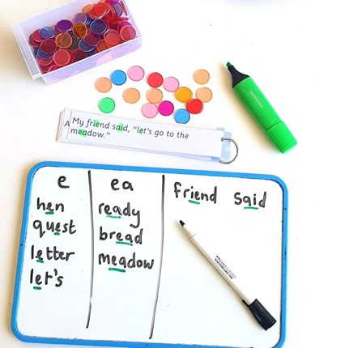
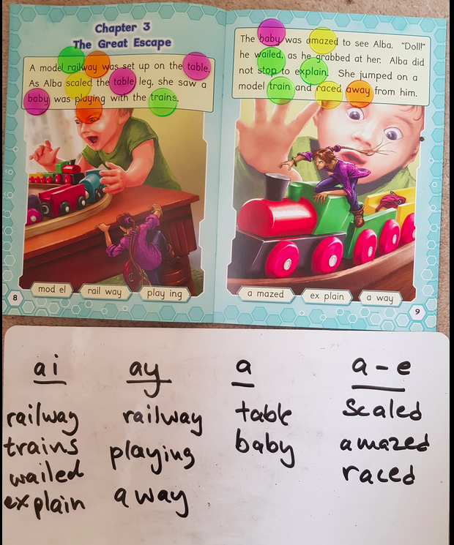
Notes:
It can be engaging...

Slide 16
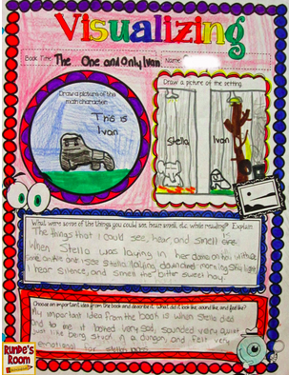
Notes:
It can be impactful and fun.

Slide 17
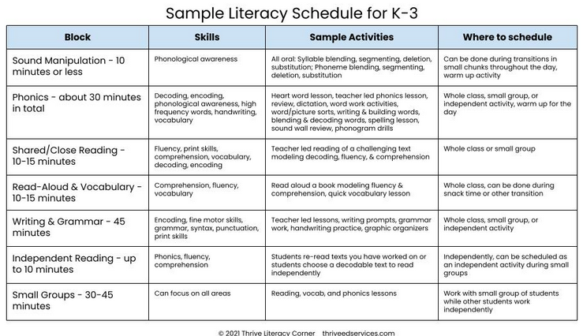
Notes:
There are a variety of ways that teachers can design literacy blocks to include the teaching and practice of skills in all five components of reading. A variety of skills can be practiced in small group and whole class lessons. Within the same lesson framework, variety and novelty can be included.
Here is a sample Literacy Schedule for K-3

Slide 18
Sample Grade One Literacy Week Overview
UFLI: University of Florida Literacy Institute
Instructional Activities | Day 1 | Day 2 | Day 3 | Day 4 | Day 5
Phonemic Awareness | Say It and Move It | Sorting Game (Sort pictures with 2, 3, or 4 phonemes) | Elkonin Boxes | Switch It – sound changing game | Sorting Game (Sort pictures with 2, 3, or 4 phonemes)
Phoneme- Grapheme Correspondences | Visual Drill | Visual Drill | Visual Drill | Visual Drill | Visual Drill
 | Auditory Drill (Present phonemes) | Auditory Drill (Present phonemes) | Auditory Drill (Present phonemes) | Auditory Drill (Present phonemes) | Auditory Drill (Present phonemes)
Decoding and Encoding | Word List Regular Word Spelling | Blending Drill | Word Sort Regular Word Spelling | Word Work Mat | Blending Drill Regular Word Spelling
Irregular & High Frequency Words | Irregular Words – Review & Practice | Irregular Words – Review & Practice | Irregular Words – Review & Practice | Irregular Words – Review & Practice | Irregular Words – Review & Practice
Writing | Practice: letter formation, printing sounds, words, sentences | Practice: letter formation, printing sounds, words, sentences | Practice: letter formation, printing sounds, words, sentences | Practice: letter formation, printing sounds, words, sentences | Practice: letter formation, printing sounds, words, sentences
Connected Text to Phoneme/Grapheme Focus | Decodable Text : Fiction or Non-Fiction Passage Connected to Lesson | Decodable Text : Fiction or Non-Fiction Passage Connected to Lesson | Decodable Text : Fiction or Non-Fiction Passage Connected to Lesson | Decodable Text : Fiction or Non-Fiction Passage Connected to Lesson | Decodable Text : Fiction or Non-Fiction Passage Connected to Lesson
Connected Text- Background Knowledge, Vocabulary & Comprehension | Rich read alouds, targeted vocabulary and discussion | Rich read alouds, targeted vocabulary and discussion | Rich read alouds, targeted vocabulary and discussion | Rich read alouds, targeted vocabulary and discussion | Rich read alouds, targeted vocabulary and discussion
Notes:
Here is a sample of a possible grade one literacy week overview.

Slide 19
Sample Grade Two Literacy Week Overview
UFLI: University of Florida Literacy Institute
Instructional Activities | Day 1 | Day 2 | Day 3 | Day 4 | Day 5
Phonemic Awareness | Tap it/Map it/Graph it | Say It and Move It | Elkonin Boxes, | Sorting Game | Switch it (sound changing game)
Phoneme Grapheme Correspondences | Visual Drill (Present graphemes) Auditory Drill (Present phonemes) | Visual Drill (Present graphemes) Auditory Drill (Present phonemes) | Visual Drill (Present graphemes) Auditory Drill (Present phonemes) | Visual Drill (Present graphemes) Auditory Drill (Present phonemes) | Visual Drill (Present graphemes) Auditory Drill (Present phonemes)
Decoding and Encoding | Regular Word Spelling *syllable types | Word Work Mat *morphemes | Word Work Mat | Regular Word Spelling | Word Sort (oi & oy)
Irregular & High Frequency Words | Irregular Words – Review (slides) & Intro (cards) | Irregular Words – Review (slides) | Irregular Words – Review (slides) & Intro (cards) | Irregular Words – Review (slides) | Irregular Words – Review (slides) & Intro (cards)
Writing | Sentence Writing | Sentence Writing | Sentence Writing | Sentence Writing | Sentence Writing
Connected Text: Fluency & Accuracy | Decodable Book Non/Fiction Passage | Decodable Book Non/Fiction Passage | Decodable Book Non/Fiction Passage | Decodable Book Non/Fiction Passage | Decodable Book Non/Fiction Passage
Connected Text- Background Knowledge, Vocabulary & Comprehension | Rich read alouds, targeted vocabulary and discussion | Rich read alouds, targeted vocabulary and discussion | Rich read alouds, targeted vocabulary and discussion | Rich read alouds, targeted vocabulary and discussion | Rich read alouds, targeted vocabulary and discussion
Notes:
Here is a sample of a possible grade two literacy week overview.

Slide 20
Sample Grade Three Literacy Week Overview
UFLI: University of Florida Literacy Institute
Instructional Activities | Day 1 | Day 2 | Day 3 | Day 4 | Day 5
Phonemic Awareness | If needed | If needed | If needed | If needed | If needed
Phoneme- Grapheme Correspondences | Visual Drill (Graphemes, syllables, and/or morphemes) | Visual Drill (Graphemes, syllables, and/or morphemes) | Visual Drill (Graphemes, syllables, and/or morphemes) | Visual Drill (Graphemes, syllables, and/or morphemes) | Visual Drill (Graphemes, syllables, and/or morphemes)
 | Auditory Drill (Present phonemes or morphemes) | Auditory Drill (Present phonemes or morphemes) | Auditory Drill (Present phonemes or morphemes) | Auditory Drill (Present phonemes or morphemes) | Auditory Drill (Present phonemes or morphemes)
Decoding and Encoding | Word Work Mat |  | Word Work Mat | Syllable Types | Word Work Mat
 | Morphemes |  | Morphemes |  | Morphemes
 |  | Syllable Types |  | Syllable Types
 |  | Regular Word Spelling | Regular Word Spelling | Regular Word Spelling
Irregular & High Frequency Words | If needed |  | If needed |  | If needed
Connected Text – Fluency & Accuracy |  | High Frequency Word Phrases |  | High Frequency Word Phrases
 | Oral Reading Fluency- (one minute per student with teacher) -Partner reading or individual | Oral Reading Fluency- (one minute per student with teacher) -Partner reading or individual | Oral Reading Fluency- (one minute per student with teacher) -Partner reading or individual | Oral Reading Fluency- (one minute per student with teacher) -Partner reading or individual | Oral Reading Fluency- (one minute per student with teacher) -Partner reading or individual
Connected Text- Background Knowledge, Vocabulary & Comprehension | Rich read alouds, targeted vocabulary and discussion | Rich read alouds, targeted vocabulary and discussion | Rich read alouds, targeted vocabulary and discussion | Rich read alouds, targeted vocabulary and discussion | Rich read alouds, targeted vocabulary and discussion
Writing | Sentence Writing | Sentence Writing | Sentence Writing | Sentence Writing | Sentence Writing
Notes:
Here is a sample of a possible grade three literacy week overview.

Slide 21
Sample Literacy Schedule for grades 4-7
Block | Skills | Sample Activities | Where to Schedule
Shared Reading through many disciplines – 45 minutes | Decoding, vocabulary, comprehension, fluency, word study, writing | Choral reading, partner reading, discussion, text-based writing, read aloud, shared writing | Whole Class
Language Arts – 45 minutes | Grammar, writing, encoding, morphology | Grammar and spelling lessons, morphology, lessons, graphic organizers for writing | Whole Class
Group Work/intervention - 45 minutes | Fluency, comprehension, vocabulary, decoding, encoding, word study, High Frequency Words (if needed), phonological awareness (if needed) | Teacher led reading of a challenging text modelling decoding, fluency & comprehension, text-based writing, self-selected reading, vocabulary lesson, word study | Small Group
Notes:
Here is a possible sample of a literacy schedule for Grades 4-7

Slide 22
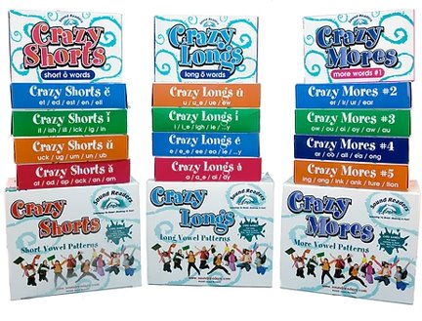
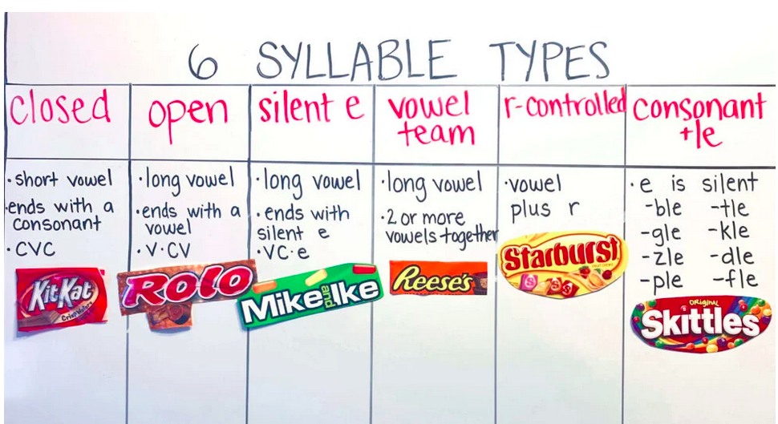
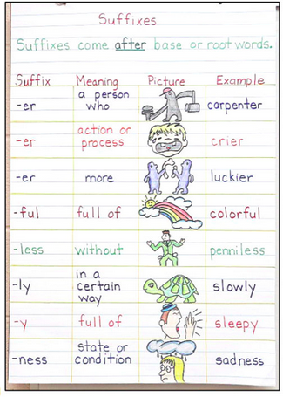
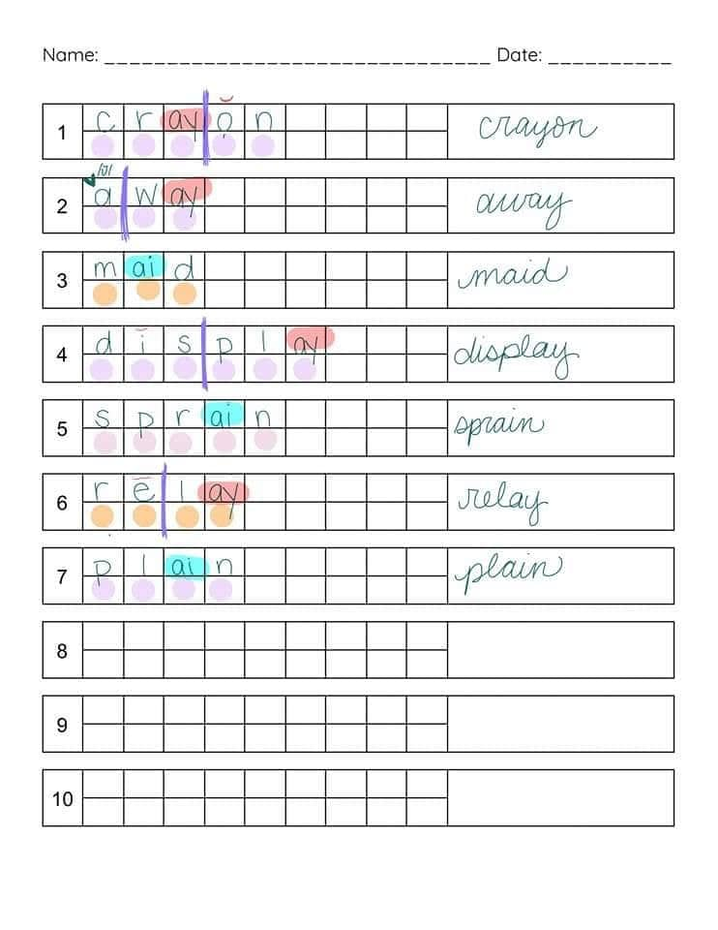
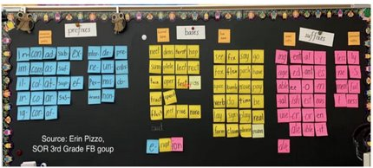
What Can It Look Like? - Intermediate
Notes:
A variety of interactive and engaging activities support learning in all 5 critical components. You can see work on morphology, syllable types, phoneme-grapheme mapping and an example of a card game for practice of phonics and vocabulary.

Slide 23
In Grades 8-12
Identifying and teaching the literacies of each discipline
Explicit, discipline based-content vocabulary
Engaging prior and building new background knowledge
Explicit instruction and practice of comprehension strategies
What Can Tier 1 Look Like?​
Components of Adolescent Literacy Instruction
Notes:
Tier 1 in grades 8-12 includes explicit instruction, practice of strategies and literacy in multi-disciplines.

Slide 24
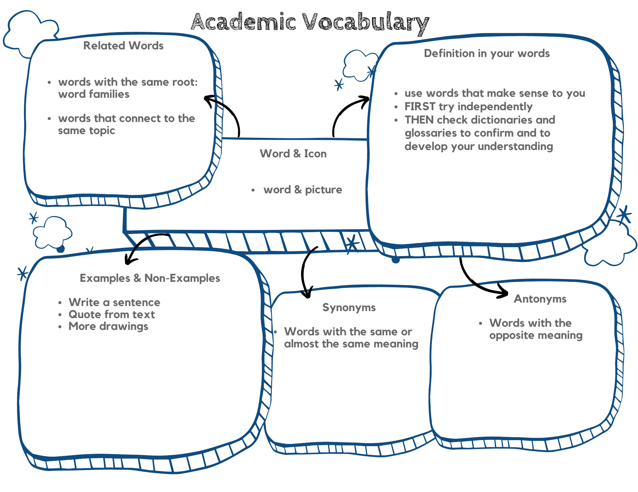
Intermediate to Secondary
Notes:
Vocabulary is increasingly important for intermediate and secondary students. There are a variety of strategies and activities to engage students and explicitly teach vocabulary.

Slide 25
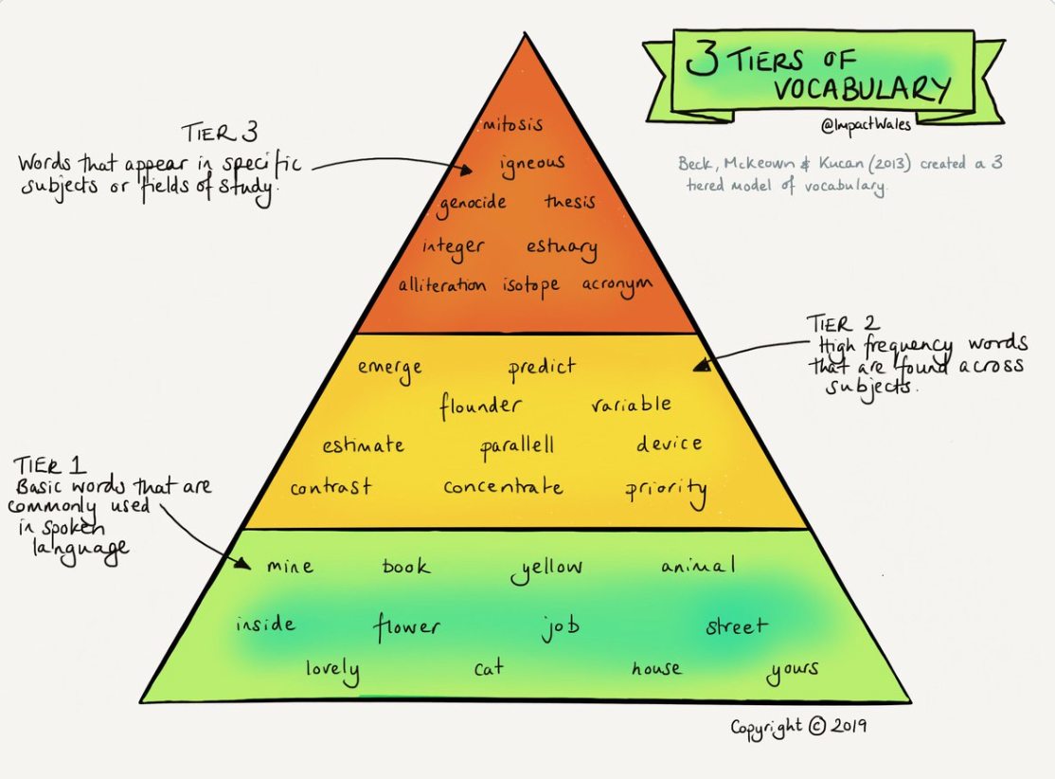
Notes:
For instructional purposes, in K-12, vocabulary words are sorted into three tiers: Tier 1, Tier 2, and Tier 3. The illustration above shows the three tiers of vocabulary. As you can see, we move from Tier 1 on the bottom of the triangle up to Tier 3 at the top of the triangle. Tier 1 vocabulary words consist of basic, familiar words. These words are commonly used by most students in everyday conversation. Students have the highest exposure with Tier 1 words.
Tier 2 vocabulary words are robust, high-frequency words that students encounter across the content areas. They are not widely used in speech and daily conversation. Unlike Tier 1 words, Tier 2 words are not usually learned naturally or independently because students do not hear or use them in conversation. A key point to understand is that Tier 2 words are often used and found in books and written text.
Tier 3 vocabulary words are low-frequency words. These words are content specific and have distinct meanings and purposes.

Slide 26
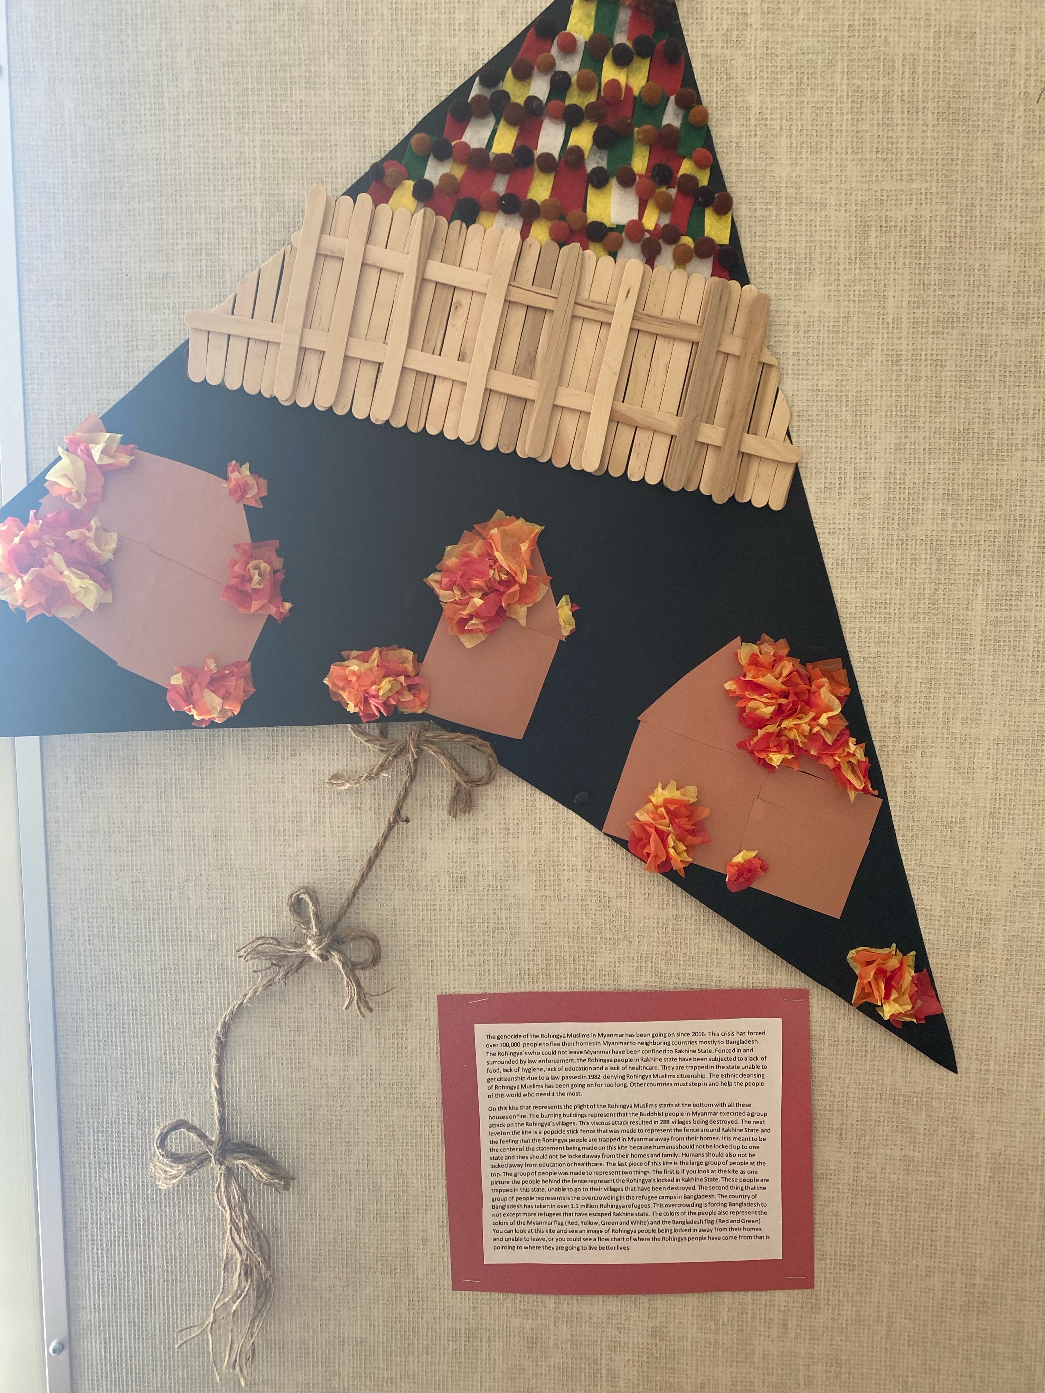
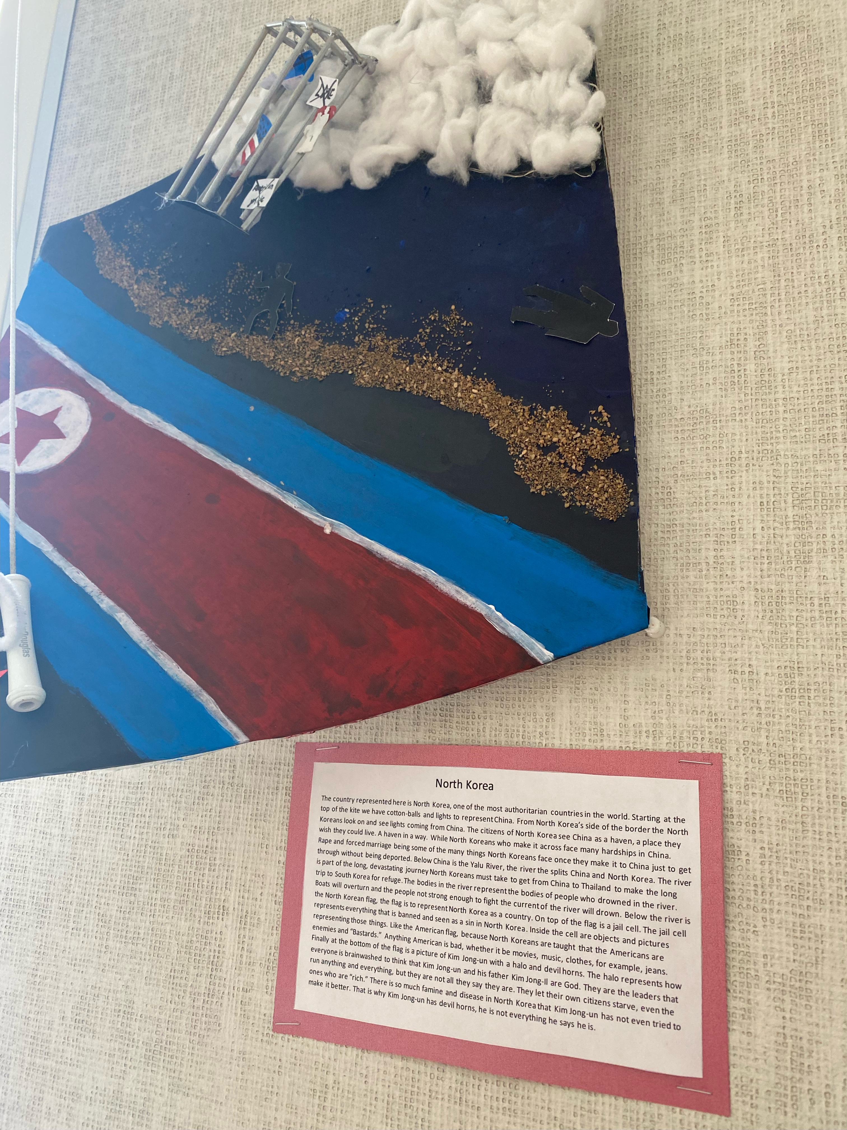
Kite Runner Novel Study
Notes:
These are sample projects made by Cowichan Secondary students.

Slide 27
Reading in Cowichan​
Tier One Practices
​
Notes:
To embed in all as appropriate:
Multi-sensory
Play-based
Trauma-sensitive
Validate what’s happening already
First Peoples Principles of Learning
Connect to Strategic Plan
Culture of Care

